Slide 1

School of Electrical Engineering and Computer Science
Department of Electrical Engineering
EE-371: Control Systems
Lecture#35
DESIGN VIA ROOT LOCUS
9. 4 Improving Steady-State Error and Transient Response
Textbook: Chapter # 09 (5th edition)
Text Book: Control Systems Engineering by Norman S. Nise 5th Edition
Instructor: Ms Neelma Naz
Class: BEE 12 C/D

Slide 2
Ideal Derivative Compensation (PD)

Slide 3

Transient response of a system can be selected by choosing an appropriate closed-loop pole location on the s-plane
One way to speed up the original system is to add a single zero to the forward path
Transient responses unattainable by a simple gain adjustment can be obtained by augmenting the system's poles and zeros with an ideal derivative compensator

Slide 4
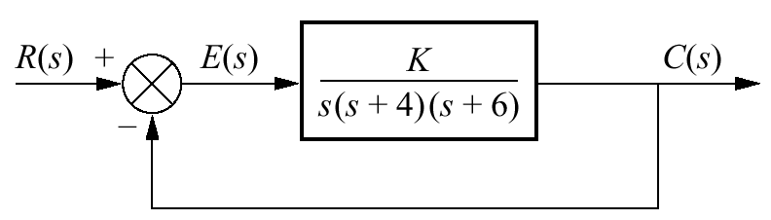
Example 9.3
Ideal Derivative Compensator Design
PROBLEM: Given the system shown in the Figure, design an ideal derivative compensator to yield a 16% overshoot, with a threefold reduction in settling time.

Slide 5
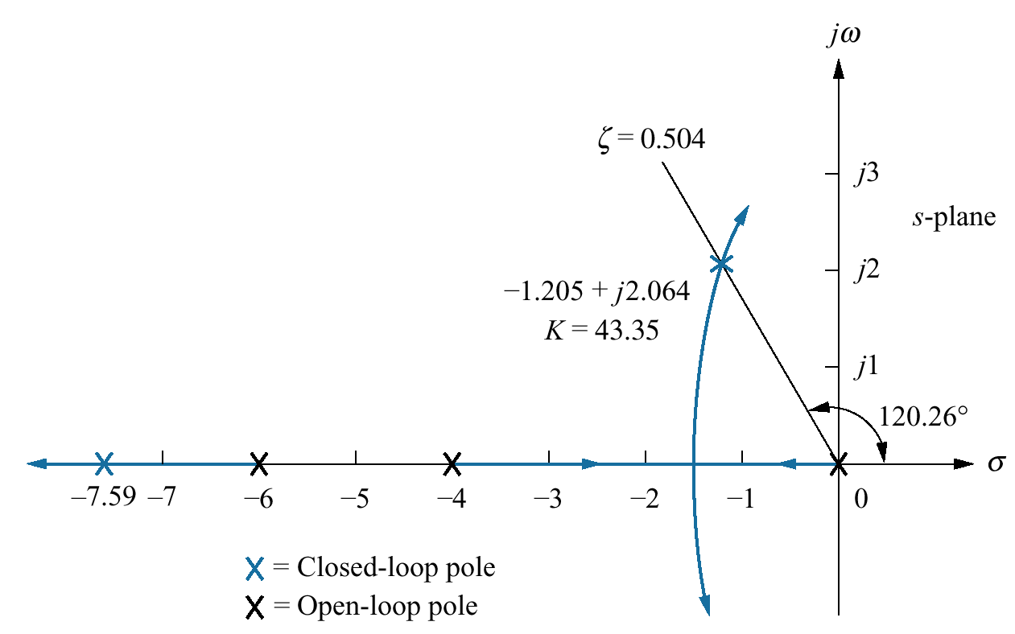
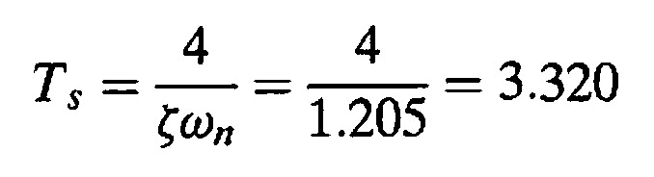
SOLUTION: Evaluate the performance of the uncompensated system operating with 16% overshoot.
The root locus for the uncompensated system is:
Since 16% overshoot is equivalent to ζ = 0.504
The dominant, second-order pair of poles is at -1.205 ±j2.064
Settling time of the uncompensated system is

Slide 6
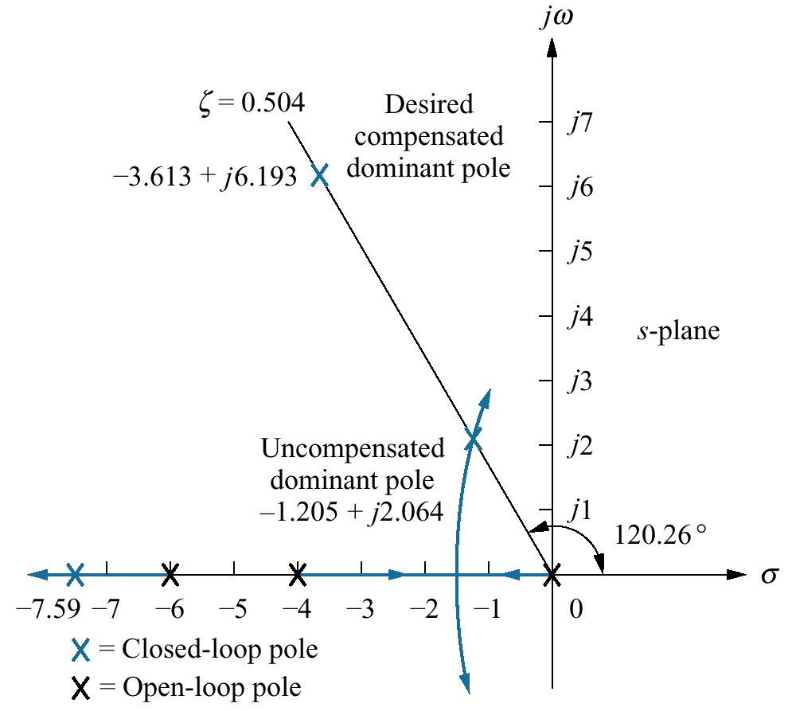
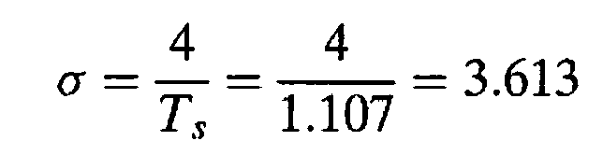
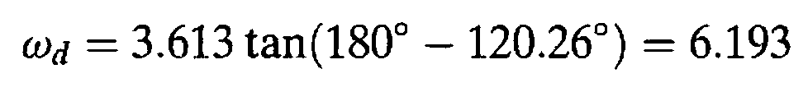
Compensated dominant pole superimposed over the uncompensated root locus
To compensate the system, first we find the location of the compensated system's dominant poles.
To have a threefold reduction in the settling time, the compensated system's settling time will be 1.107.
Therefore, the real part of the compensated system's dominant, second-order pole is:
and

Slide 7
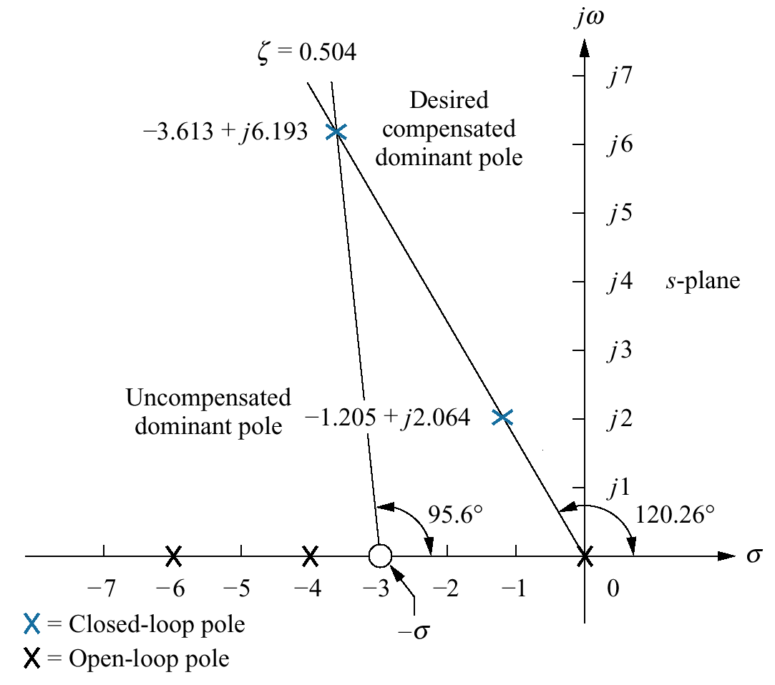
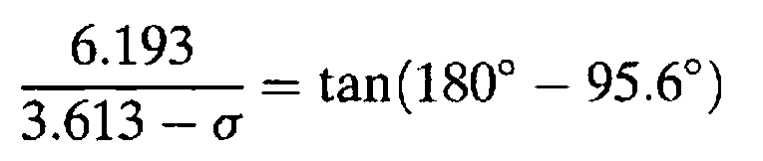

Evaluating the location of the compensating zero
The sum of the angles from the open loop poles to the desired dominant pole is
- 275.6
The angular contribution required from the compensator zero for the test point to be on the root locus is
- 180°-(-275.6°) = 95.6
From the geometry

Slide 8
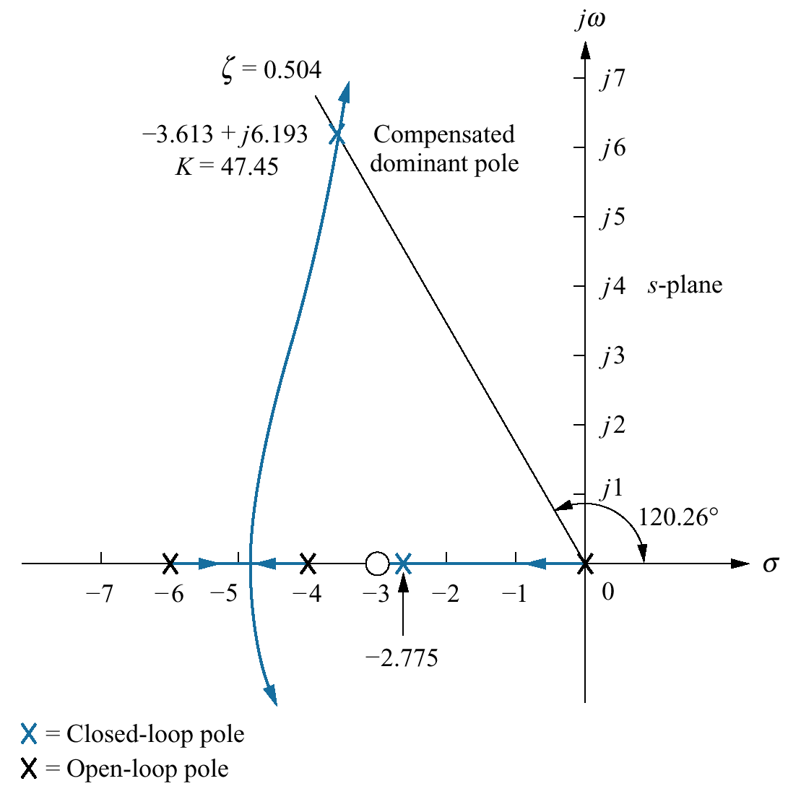
Root locus for the
compensated system

Slide 9
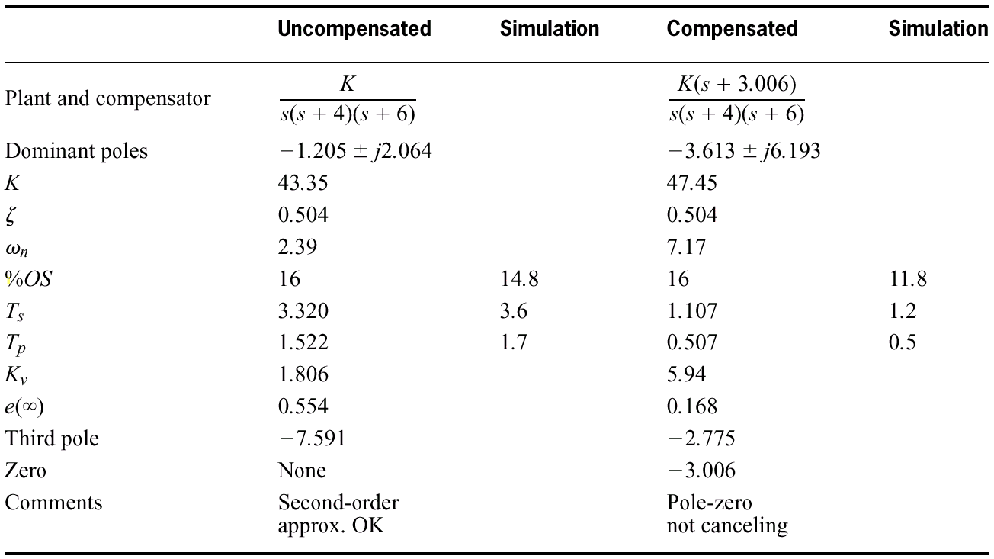
Table 9.3
Uncompensated and compensated system characteristics for Example 9.3

Slide 10
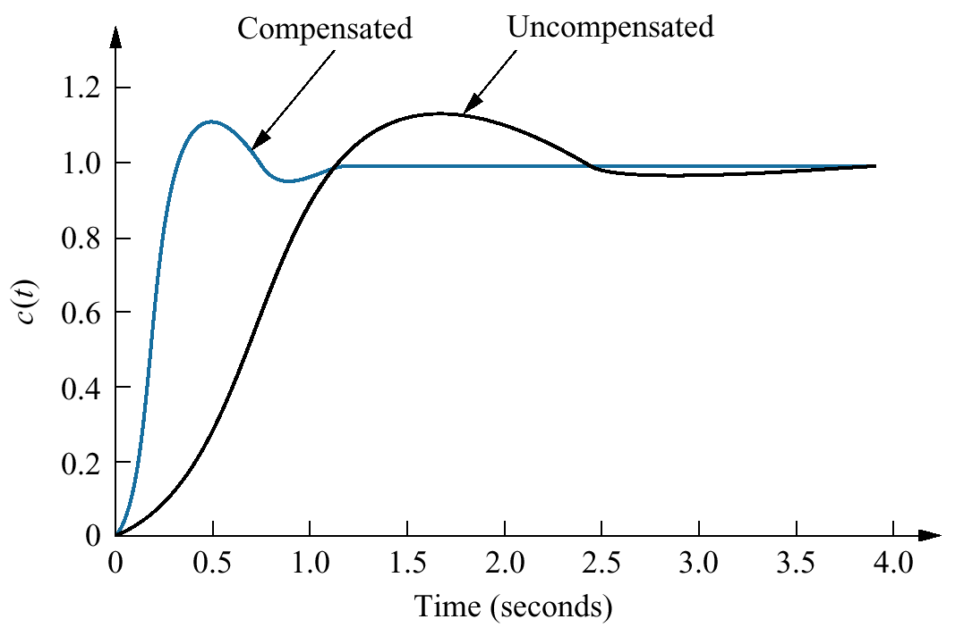
Uncompensated and
compensated system step responses

Slide 11
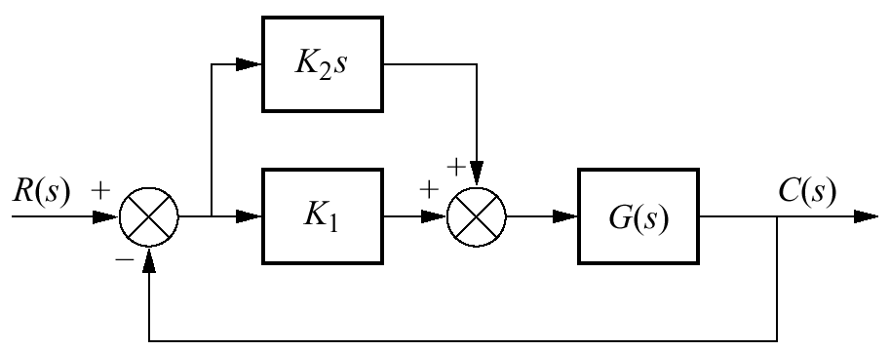
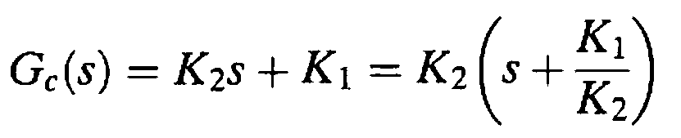
Implementation of ideal derivative (PD) controller
K1/K2 is chosen to equal the negative of the compensator zero
K2 is chosen to contribute to the required loop-gain value

Slide 12
Lead Compensation
An active ideal derivative compensator can be approximated with a passive lead compensator
When passive networks are used, a single zero cannot be produced; rather, a compensator zero and a pole result
If the pole is farther from the imaginary axis than the zero, the angular contribution of the compensator is still positive and thus approximates an equivalent single zero

Slide 13
Lead Compensation
If we select a desired dominant, second-order pole on the s-plane, the sum of the angles from the uncompensated system's poles and zeros to the design point can be found
The difference between 180° and the sum of the angles must be the angular contribution required of the compensator

Slide 14
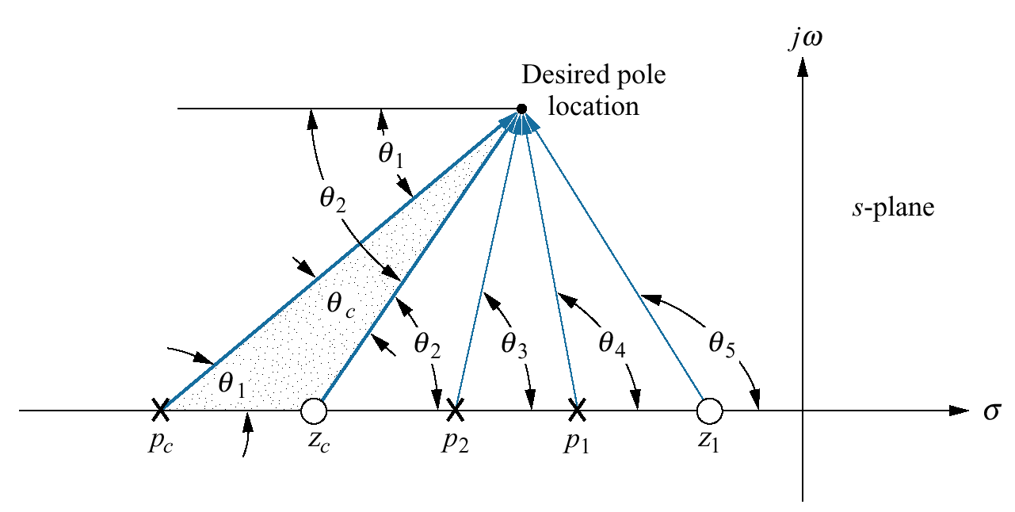
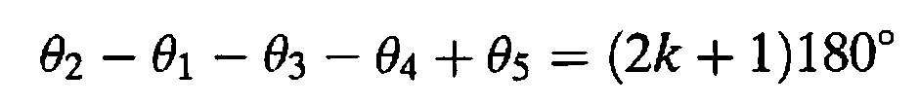
Geometry of lead
compensation
(θ₂ - θ₁ = θ_{c}) is the angular contribution of the lead compensator

Slide 15
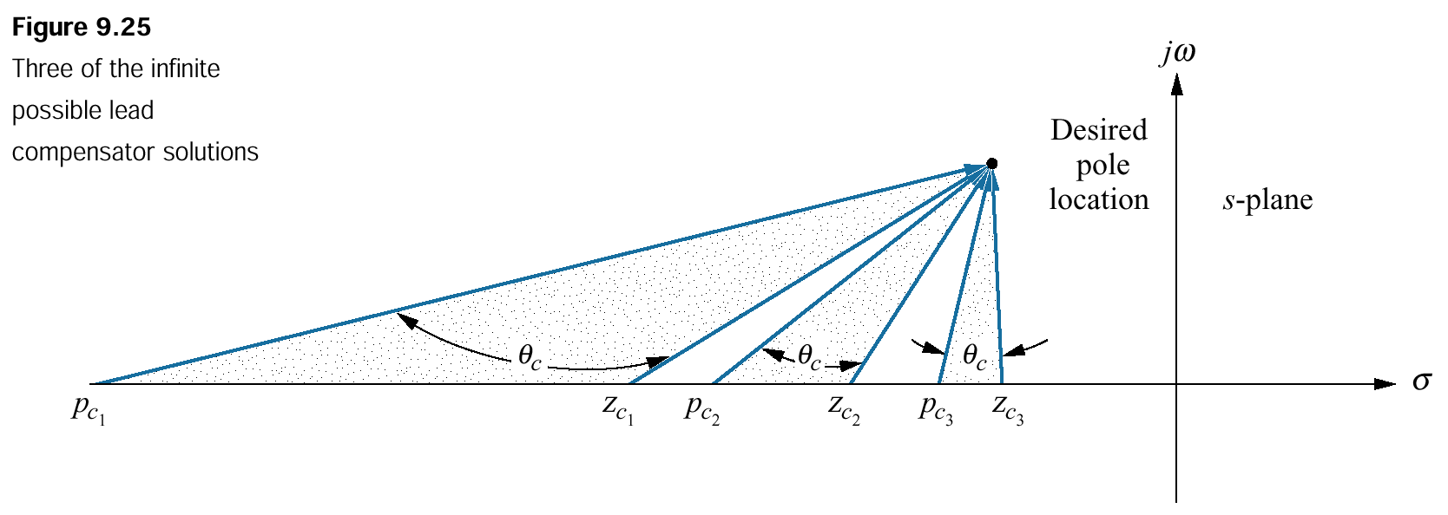
An infinite number of lead compensators could be used to meet the transient response requirement
Three of the infinite possible lead compensator solutions

Slide 16
How do the possible lead compensators differ?
The differences are in the values of :
Static error constants,
The gain required to reach the design point on the compensated root locus
The difficulty in justifying a second-order approximation when the design is complete
The transient response

Slide 17
Assignment
Work out Example 9.4 and
Skill-Assessment Exercise 9.2

Slide 18
PID Controller Design
&
Lag Lead Compensator design

Slide 19
We first design for transient response and then design for steady-state error
If we design an active PD controller followed by an active PI controller,
the resulting compensator is called a
proportional-plus-integral-plus-derivative (PID) controller
If we first design a passive lead compensator and then design a passive lag compensator,
the resulting compensator is called a
lag-lead compensator

Slide 20
PID Controller Design

Slide 21
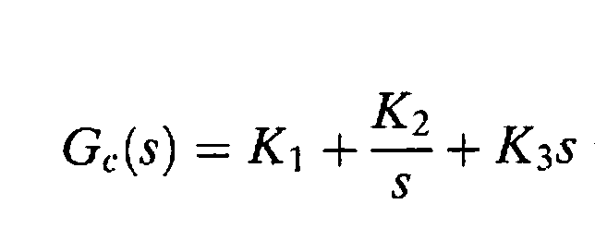
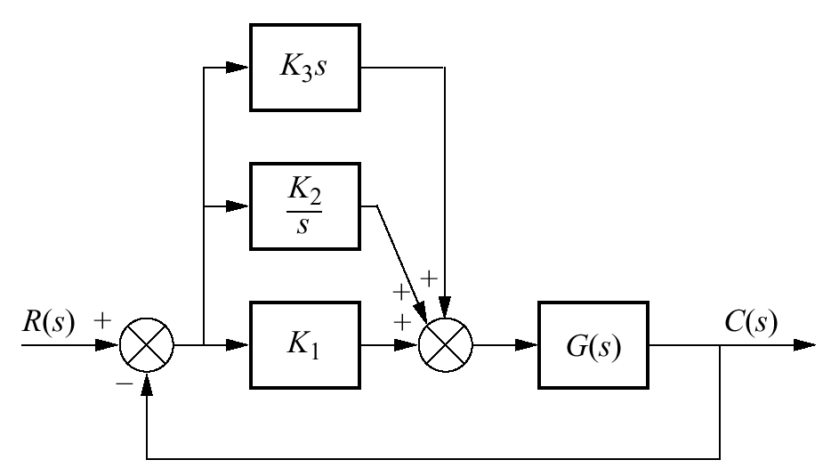
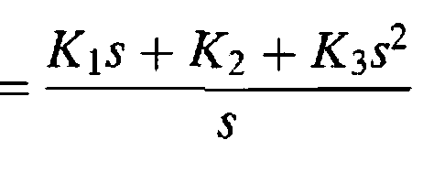
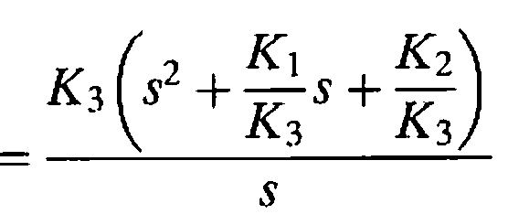
How many poles and zeros ???
One zero and the pole at the origin can be designed as the ideal integral compensator
The other zero can be designed as the ideal derivative compensator

Slide 22
The design technique
1. Evaluate the performance of the uncompensated system to determine how much improvement in transient response is required.
2. Design the PD controller to meet the transient response specifications. The design includes the zero location and the loop gain.
3. Simulate the system to be sure all requirements have been met.
Redesign if the simulation shows that requirements have not been met.
5. Design the PI controller to yield the required steady-state error.

Slide 23
The design technique
6. Determine the gains, K₁, K₂, and K₃
7. Simulate the system to be sure all requirements have been met.
8. Redesign if simulation shows that requirements have not been met.

Slide 24
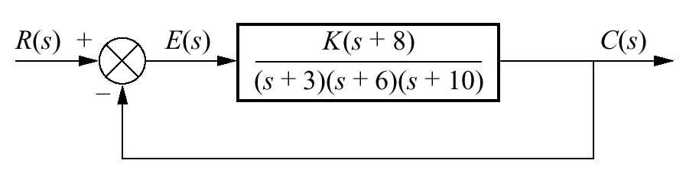
Example 9.5
PID Controller Design
PROBLEM: Given the system shown in the Figure, design a PID controller so that the system can operate with a peak time that is two-thirds that of the uncompensated system at 20% overshoot and with zero steady-state error for a step input.

Slide 25
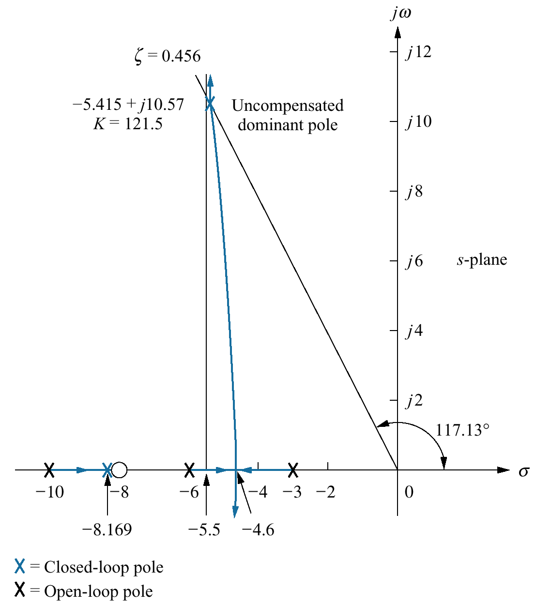

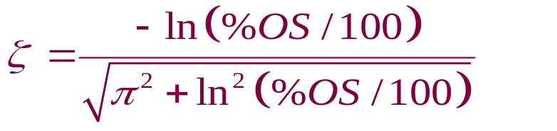
Evaluate the uncompensated system operating at 20% overshoot.
Searching along the 20% overshoot line (ζ = 0.456), the dominant poles are found to be -5.415 ±j10.57 with a gain of 121.5.
Third pole, which exists at -8.169 is found by finding roots of the characteristic polynomial for K = 121.5.
0.297sec
Estimated T_{p} = π/ω_{d} =
%OS = 20

Slide 26
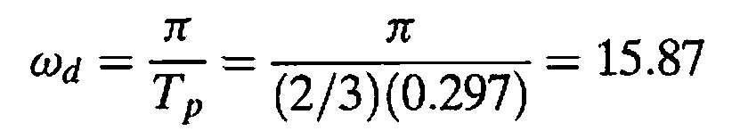
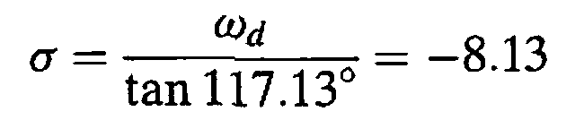
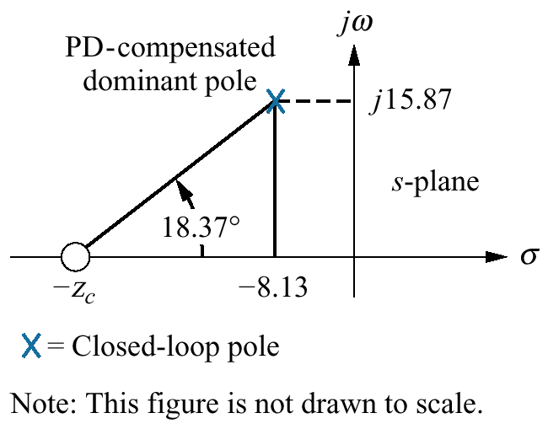
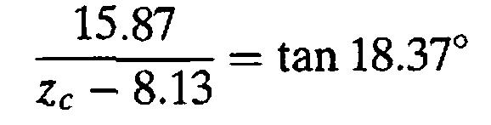


Finding the compensated system's dominant pole location
Imaginary part
Real part
The sum of angles from the uncompensated system's poles and zeros to the desired compensated dominant pole come out to be -198.37°.
The angle contribution required from the compensator zero is:
198.37° - 180° = 18.37°.
From the geometry the compensating zero's location
is worked out
The PD controller is

Slide 27
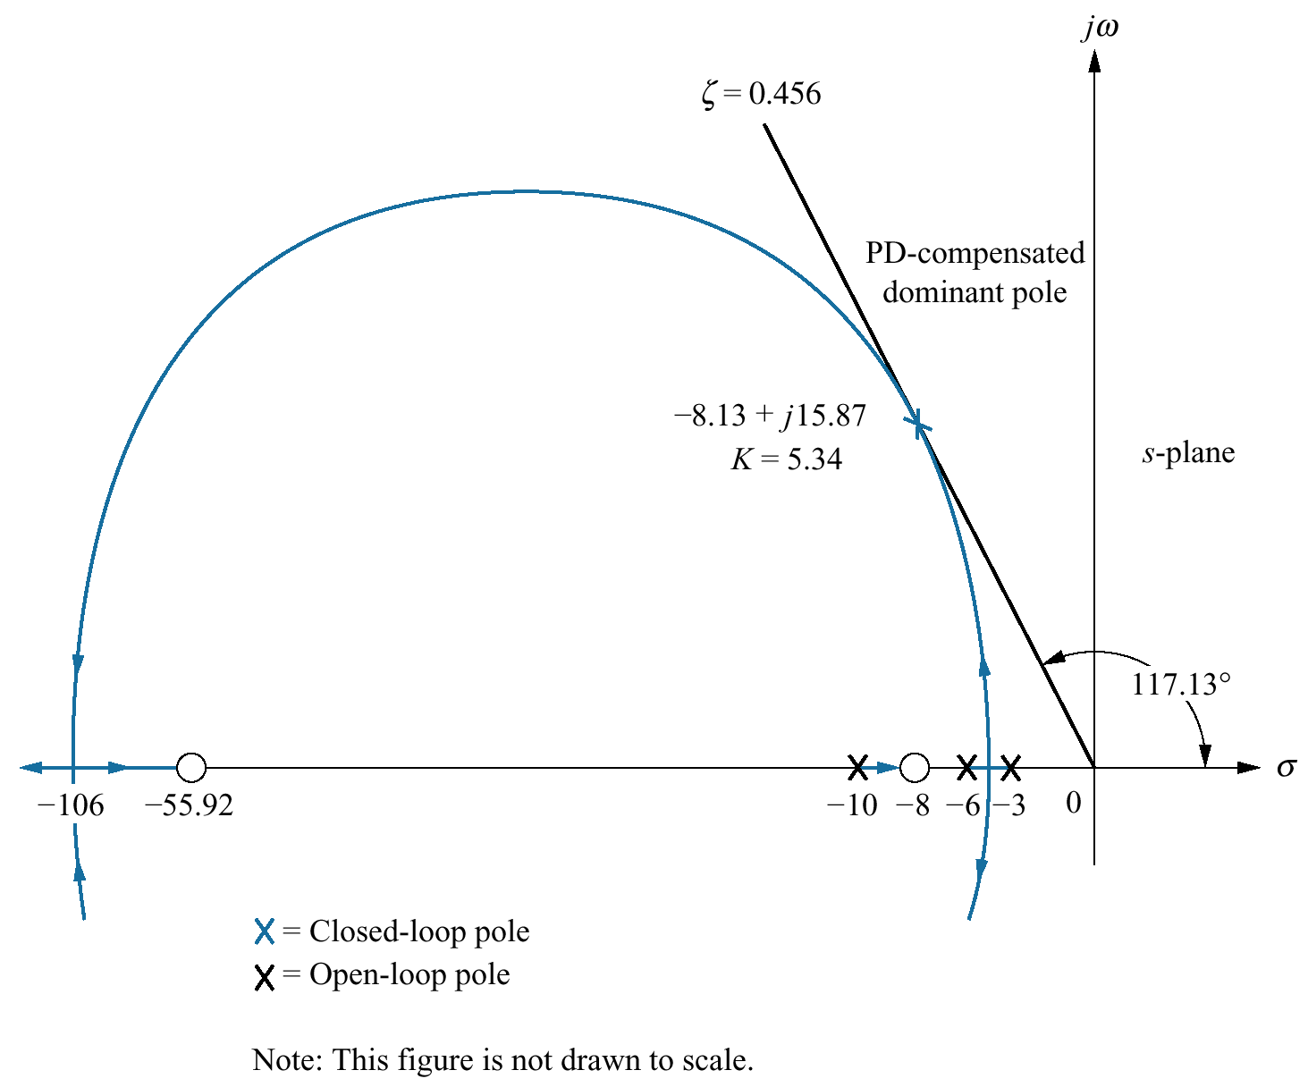
Root locus for PD-compensated system

Slide 28
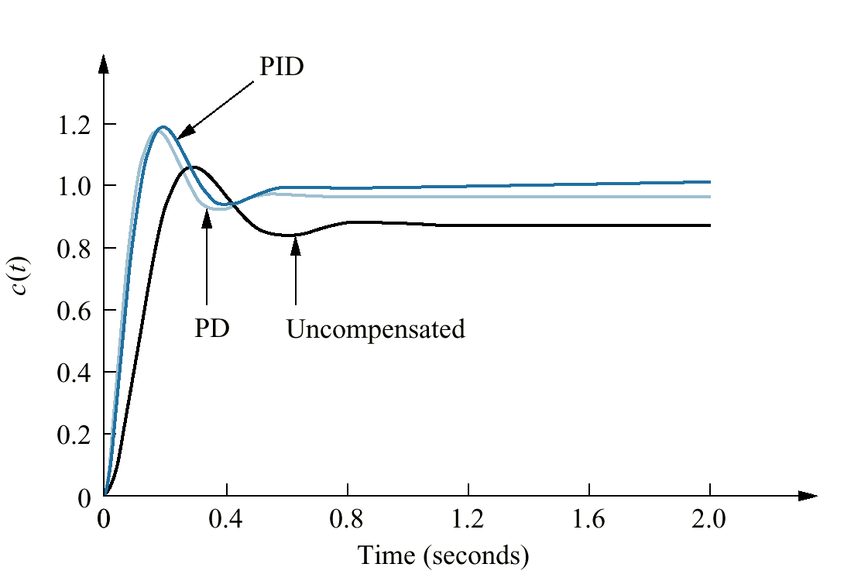
Simulation of the PD controller, in addition to reduction in T_{p}, indicates improvement in steady state error

Slide 29
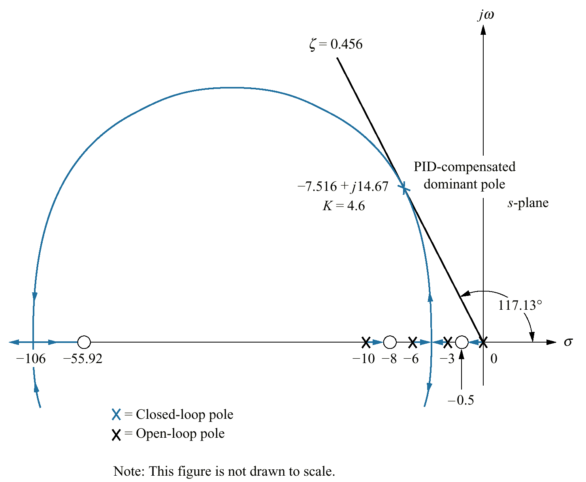
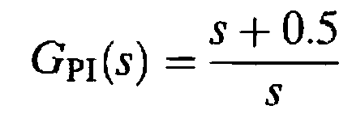
Root locus for PID-compensated system
Designing ideal integral compensator to reduce the steady-state error to zero for a step input

Slide 30
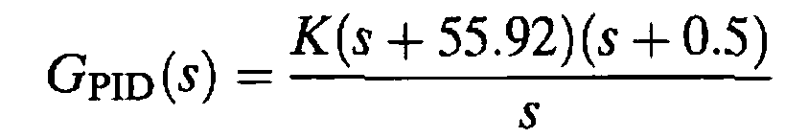
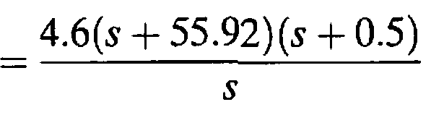
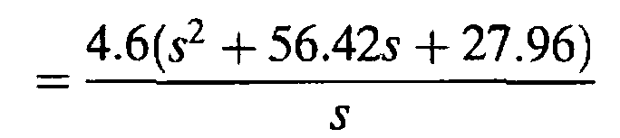
Now determine the gains, K₁,K₂, and K₃
G_{C}(s)
K₁ = 259.5,
K₂ = 128.6, and
K₃ = 4.6

Slide 31
Lag-Lead Compensator Design

Slide 32
Improve both
the transient response and
the steady-state error
by using
a lead compensator and
a lag compensator
instead of the ideal PID

Slide 33
The design technique
Design the lead compensator to improve the transient response.
Evaluate the improvement in steady-state error still required
Design the lag compensator to meet the steady-state error requirement.

Slide 34
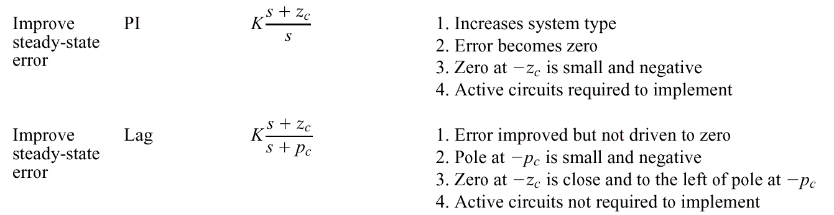
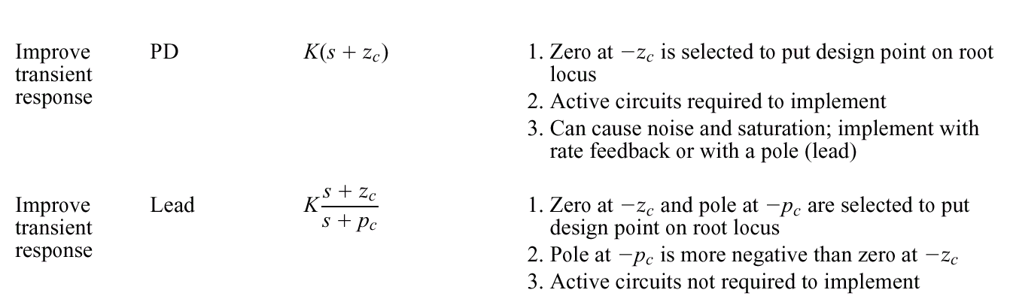
Types of cascade compensators (slide 1 of 2)

Slide 35
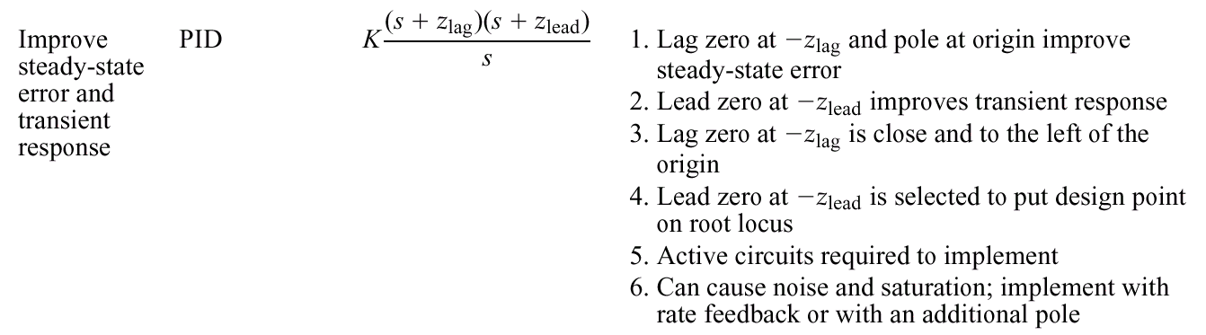
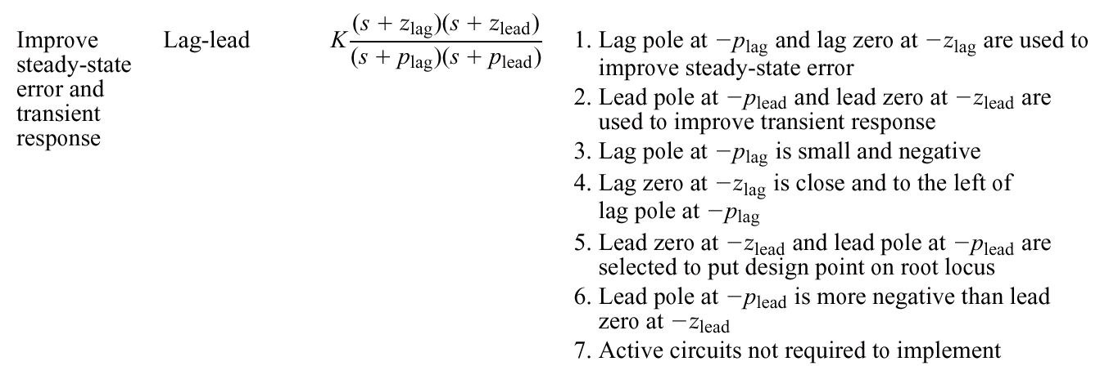
Types of cascade compensators (slide 2 of 2)

Slide 36
Assignment
Example 9.6 to be submitted

Slide 37
Root Locus for Positive-Feedback
Systems

Slide 38
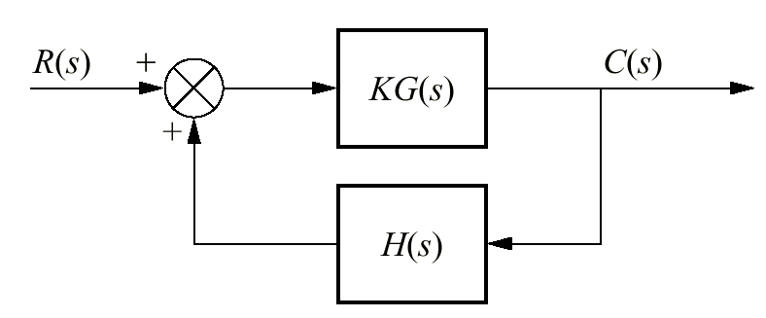
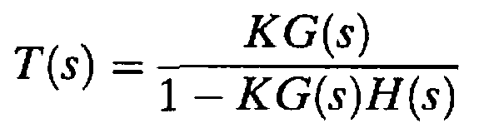


A positive-feedback system can be thought of as a negative-feedback system with a negative value of H(s)
The transfer function for the positive-feedback System is:

Slide 39
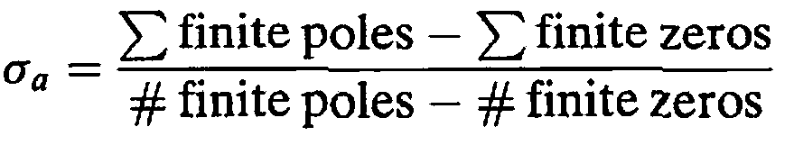
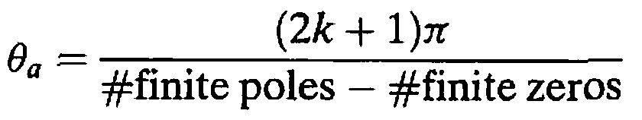
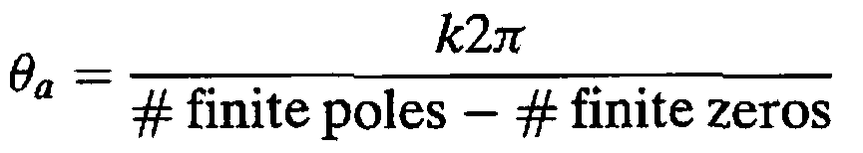
Real-axis segments:
On the real axis, the root locus for positive-feedback systems exists to the left of an even number of finite open-loop poles and/or finite open-loop zeros.
the real-axis intercept
For negative feedback system
Angle with the real axis

Slide 40
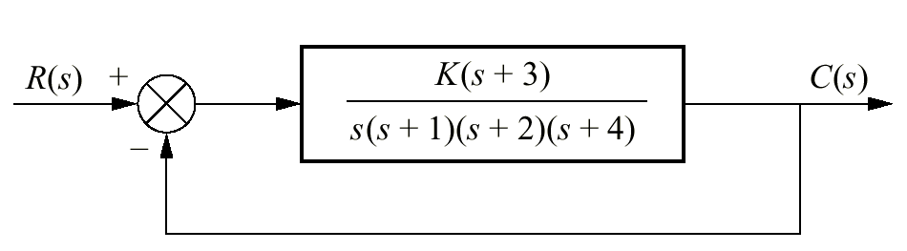
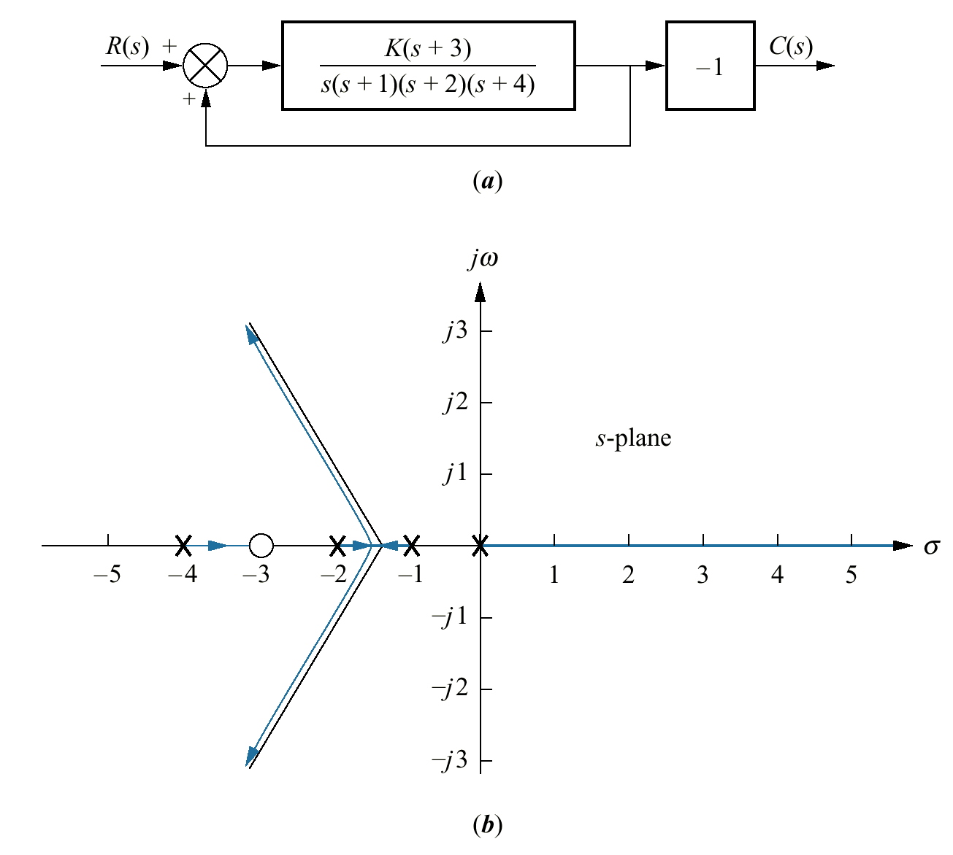
Example 8.9
Root Locus for a Positive-Feedback System
PROBLEM: Sketch the root locus as a function of negative gain, K, for the system shown in the Figure.
_
SOLUTION: The equivalent positive-feedback system found by pushing -1, associated with K, to the right past the pickoff point is:

Slide 41
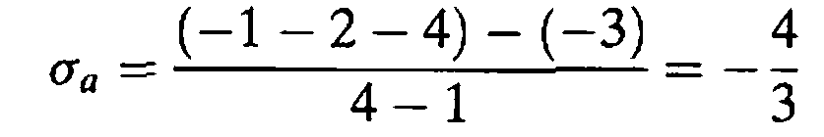
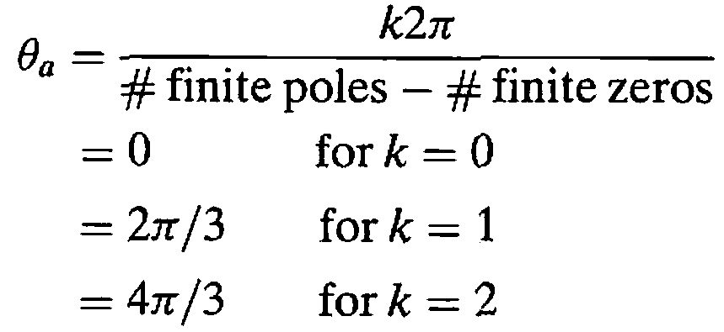

Slide 42

???

